Slide 1

INTERNSHIP OVERVIEW EMBEDDED SYSTEMS
RESHMA SHAIK
JULY 2025
SV TECHNOLOGIES

Slide 2

INTRODUCTION
• Name: Reshma Shaik
• Course: B.Tech E.C.E
• Internship at SV Technologies
• Duration: 30 days (June–July 2025)

Slide 3
ABOUT THE COMPANY
• Name: SV Technologies
• Industry: Embedded Systems
• Focus: Embedded software and hardware solutions.
• Offers solutions for automotive, consumer electronics, and IoT.

Slide 4

INTERNSHIP ROLE
• Role: Intern - Embedded Systems
• Department: Embedded Systems
Development
• Responsibilities: Supporting design, testing, and documentation of Embedded Systems.

Slide 5
SKILLS LEARNED
TECHNICAL SKILLS
Soft Skills
Tools
.
02
Microcontrollers,
C Programming, Embedded C, Debugging.
Communication, Time Management, Teamwork
01
03
Arduino, Keil, Proteus.
.

Slide 6
PROJECTS DONE
.
.
.
Developed a basic home automation prototype using Arduino.
Wrote and tested code for robotic arm.
Assisted in PCB design for a simple temperature monitoring system.

Slide 7
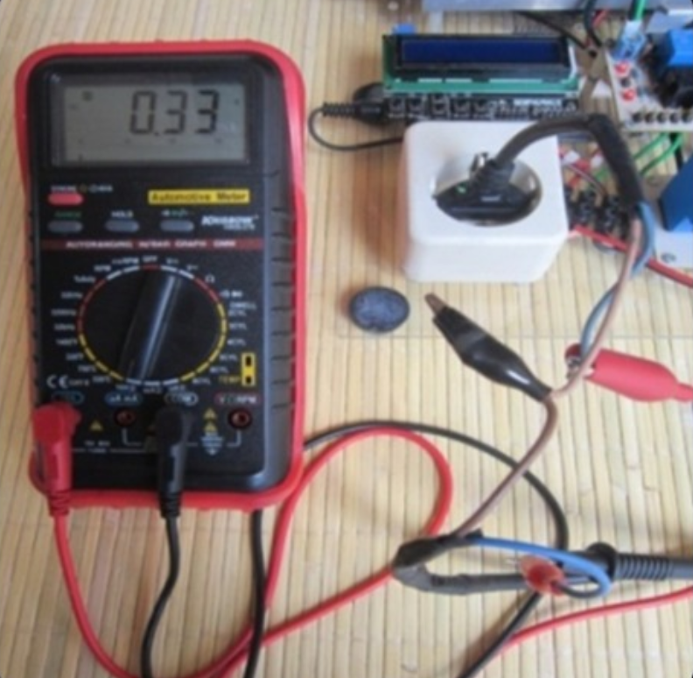
SMART HOME AUTOMATION SYSTEM
Developed a “Smart Home Automation System”that
Allows users to control appliances remotely using mobile app.
.

Slide 8
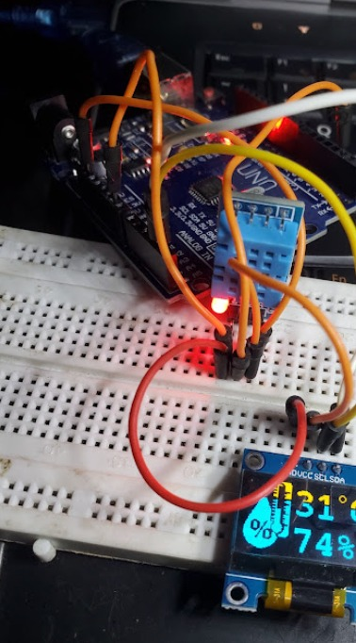
TEMPERATURE MONITORING SYSTEM
Designed and implemented a temperature monitoring system that collects data from sensors and displays it in real-time,enhancing environmental control.
.
.
.

Slide 9
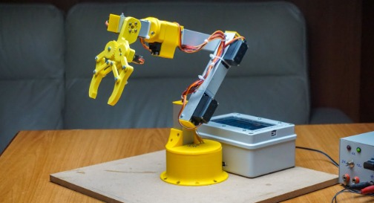
ROBOTIC ARM PROJECT
Created a Robotic Arm controlled via a joystick that demonstrates the principles of robotics and embedded programming , showcasing my skills in hardware integration.
.
.
.

Slide 10
CHALLENGES FACED
• Understanding low-level hardware interactions
• Debugging embedded C code
• Managing time to complete tasks under tight deadlines

Slide 11
KEY TAKEAWAYS
01
PROJECT BRIEFING
02
USER RESEARCH
.
03
LAUNCH
.
Improved technical and practical
knowledge of embedded systems.
Gained real-world experience
hardware/software integration.
Boosted confidence in coding and teamwork
.

Slide 12
Thank you for your time!
RESHMA SHAIK
ECE C-111624104095

